Slide 1
NE 763: Advanced Reactor Materials
Fall 2026
Dr. Benjamin Beeler

Slide 2
Last Time
UN/PuN phases with high solubility; potential decomposition at low N2 pressures
Fabricate with excess N, N slightly increases with burnup
He/Na bonded pins; He has low fuel density, small gap; Na has high fuel density, large gap;
  roughly same total smear density, same as carbides
Three (temperature) regimes evolving with burnup: initial T ramp+cracking; densification+free swelling; contact with cladding and FCMI onset
Restructuring into 3 zones: porous center, grain growth, as-fab
FCMI is a key concern due to swelling and low creep in UN fuels
Nitriding of the cladding can occur, but has not been seen to dramatically degrade cladding
Carbothermic reduction for fabrication, can lead to O/C impurities, requires very high T for sintering
LFRs, will wrap up today and summarize…

Slide 3
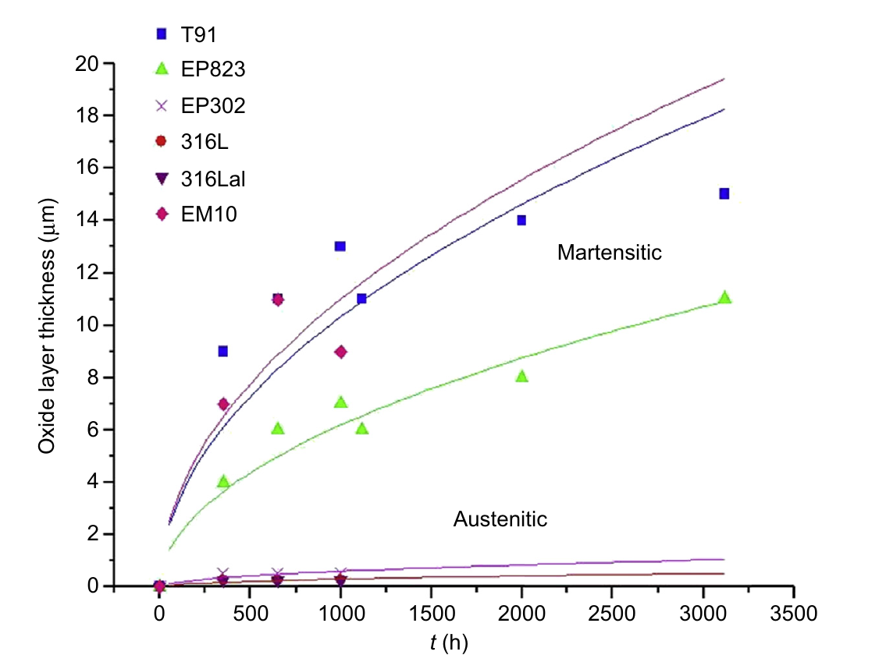
Temperature Limits for Bare Steels
Steel class | Dissolution regime (low O) | Oxidation regime (O controlled)
Austenitic (316L) | 350–400°C | 400–450°C
Ferritic/martensitic (T91) | 400–450°C | 450–500°C
Austenitic steels oxidize slowly but are vulnerable to Ni dissolution
F/M steels resist dissolution but grow overly thick oxides and suffer LME
Thick scales spall, cut heat transfer, and lose protectiveness
Above ~500°C, Al-alloying, Al₂O₃ coatings, or new alloys are needed
This practically limits the temperatures at which LFRs can operate
Oxide thickness, flowing LBE, 470°C, 1.9 m/s, [O] = 10⁻⁶ wt%. Fazio & Balbaud, Structural Materials for Gen IV Reactors (2017)

Slide 4
Surface Protection Above ~500°C
Al surface alloying
Electron beam melts an Al or FeCrAlY layer into the surface
  FeCrAlY-alloyed 15-15Ti withstood flowing LBE (10⁻⁶ wt% O) for 5000 h at 500–600°C
Hot-dip aluminizing (700C bath + anneal) and pack cementation (~750C; 40–120 μm layer)
Excess Al forms brittle Fe₂Al₅; homogeneity is difficult on large, complex parts
316L needs ~5.2–6.2 wt% Al to form Al₂O₃
Al₂O₃ coatings
PLD: amorphous Al₂O₃ with nanocrystallites resisted Pb at 550C for 4000 h, even at low O
  Low deposition T keeps AIM-1 cold work; deforms a few %; tolerates heavy-ion damage
ALD and detonation gun are promising, but HLM data are scarce
Coatings keep the substrate unchanged (easier qualification) but cannot self-heal
Must prove adhesion on large parts, stability under irradiation and strain
Bassini et al., Comprehensive Nuclear Materials 2nd ed. (2020)

Slide 5
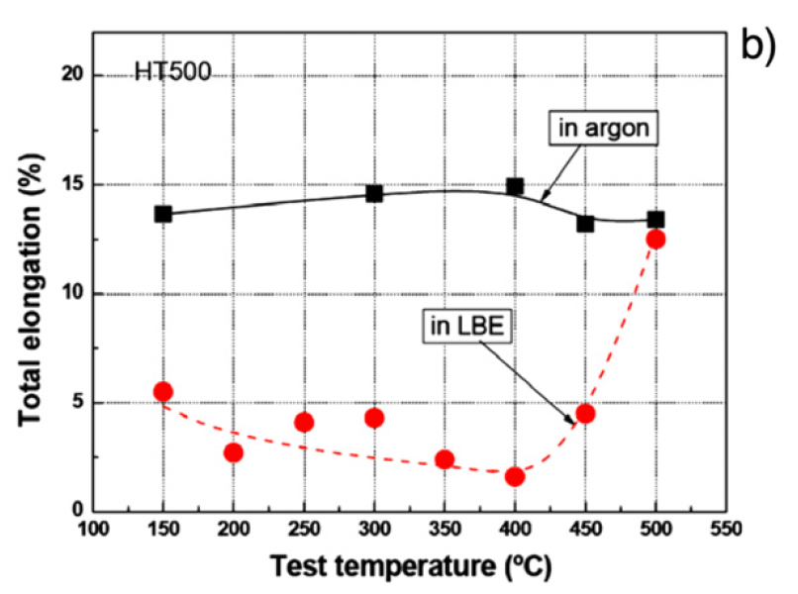
Mechanical Property Effects
Liquid metal embrittlement (LME) is a known phenomenon, but its mechanism is not fully understood
Contact with LM causes a decrease in ductility, resulting in a premature brittle failure in an otherwise ductile material
LME occurs by nucleation of a crack at the wetted surface of a solid and the subsequent propagation into the bulk until ultimate failure
The loss of ductility of solid metals when in contact with liquid metal appears to be limited to a particular temperature range known as the ductility trough

Slide 6
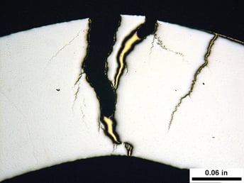
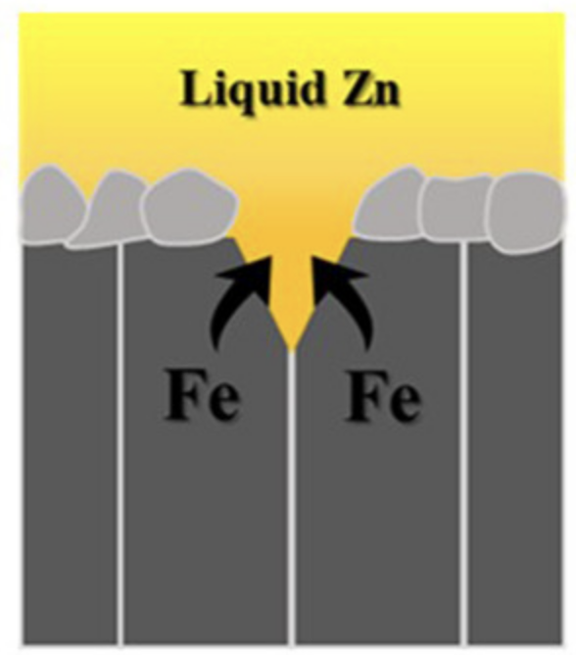
Liquid metal embrittlement (LME)
For F/M T91 steel, the ductility trough is 350–425C in liquid Pb and 160–425C in LBE
The ductility trough is detected by following the evolution of the ultimate tensile stress or energy to rupture with temperature
The working theory on LME is based on a reduction of the surface energy by absorption of liquid metal atoms at the crack tip of the solid
LME requires applied stress above the elasticity limit, contact between the liquid alloy and the steel, and extended surface defects (in the oxide) which might allow direct contact between the liquid metal and the steel

Slide 7
Summary
Pb/LBE offer high boiling points and low chemical reactivity; corrosion is the central materials challenge
High Ni solubility makes austenitic steels vulnerable
Thermal mass transport occurs in flowing loops; flow also adds flow accelerated corrosion and potentially oxide erosion
Corrosion proceeds by dissolution (low O) or oxidation (controlled O); excess O can lead to oxide precipitates
O control (~10⁻⁶–10⁻⁷ wt%) protects bare steels up to ~450C; above ~500C, Al-alloying, Al₂O₃ coatings, or new alloys (e.g., FeCrAl) are needed
LME affects F/M steels (T91) in a ductility trough; austenitic steels are largely immune

Slide 8
End of Module 3
This concludes our module 3
Exam will take place Thursday (11/5)
Will cover molten salts, carbides and nitrides, and Pb-cooled reactors

